Slide 1
Sensor Data Correlation
NC 812/ESD 812

Slide 2
Correlation Coefficient
x = randn(6,1);
y = randn(6,1);
A = [x y 2*y+3];
R = corrcoef(A)
R =
1.0000 -0.6237 -0.6237
-0.6237 1.0000 1.0000
-0.6237 1.0000 1.0000

Slide 3
Temperature and Humidity Data

Slide 4
Correlation Coefficient
>> corrcoef(temp_data, humidity1)
ans =
1.0000 -0.9522
-0.9522 1.0000

Slide 5
Correlation

Slide 6
Correlated Data
a=randn(1000,1);
>> b=2*a+1;
>> figure
>> plot(a,b,'*')

Slide 7
Correlated Data

Slide 8
Uncorrelated Data

Slide 9
Sensor Data Correlation
When the sensor data is collected from different sensors located at different locations, the data is likely to show spatial and temporal correlation. The correlation needs to be captured both across multiple streams, as well as across time (auto-correlations).
Correlations across different streams allow us to find hidden variables that can summarize collections of time series data streams. In the second case, auto-correlations summarize patterns across time, that can capture regular or periodic trends in time series streams.
Streams in a large collection are often inherently correlated (e.g., temperatures in the same building, traffic in the same network, prices in the same market, etc.) and it is possible to reduce hundreds of numerical streams into just a handful of hidden variables that compactly describe the key trends and dramatically reduce the complexity of further data processing.

Slide 10
Example
Consider a large number of sensors measuring chlorine concentration in a drinkable water distribution network, showing 15 days worth of data. Every five minutes, each sensor sends its measurement to a central node, which monitors and analyzes the streams in real time.

Slide 11
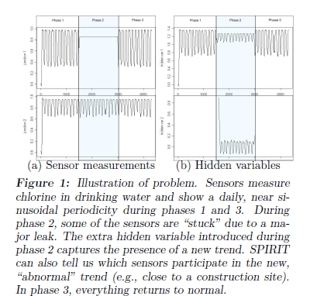
Sensor Data Correlation

Slide 12
Example
The patterns in chlorine concentration levels normally arise from water demand. If water is not refreshed in the pipes, existing chlorine reacts with pipe walls and micro-organisms and its concentration drops. However, if fresh water flows, chlorine concentration rises again.
The rise depends primarily on how much chlorine is originally mixed at the reservoirs (and also, to a small extent, on the distance to the closest reservoir—as the distance increases, the peak concentration drops slightly, due to chemical reactions along the way). Since demand typically follows a periodic pattern, chlorine concentration reflects that : it is high when demand is high and vice versa.

Slide 13
Example
Assume that at some point in time, there is a major leak at some pipe in the network. Since fresh water flows in constantly (possibly mixed with debris from the leak), chlorine concentration at the nodes near the leak will be close to peak at all times.
Figure shows measurements collected from two nodes, one away from the leak (bottom) and one close to the leak (top). At any time, a human operator would like to know any information about the data that is not obvious.
Those are the hidden variables or trends that can be detected using correlation.

Slide 14
Example
In the example, we first need to discover the correct number of hidden variables, which may change over time.
Periodic pattern.
Both observed variables (chorine content at location 1 and 2) follow this hidden variable (multiplied by a constant factor, which is the participation weight of each observed variable into the particular hidden variable).
Mathematically, the hidden variables are the principal components of the observed variables and the participation weights are the entries of the principal direction vectors.
However, during the leak, a second trend is detected and a new hidden variable is introduced. As soon as the leak is fixed, the number of hidden variables returns to one.

Slide 15
Principal Component Analysis
Principal component analysis (PCA) is a statistical procedure that uses an orthogonal transformation to convert a set of observations of possibly correlated variables into a set of values of linearly uncorrelated variables called principal components.
The number of principal components is less than or equal to the number of original variables. This transformation is defined in such a way that the first principal component has the largest possible variance (that is, accounts for as much of the variability in the data as possible), and each succeeding component in turn has the highest variance possible under the constraint that it is orthogonal to the preceding components.
The resulting vectors are an uncorrelated orthogonal basis set.

Slide 16
Principal Component Analysis
The mathematical technique used in PCA is eigen analysis. The eigenvector associated with the largest eigenvalue has the same direction as the first principal component.
The eigenvector associated with the second largest eigenvalue determines the direction of the second principal component and so on.
Eigenvalue and vector determination can done using in built functions in Matlab or R or code can be written easily.

Slide 17
Toy Example

Slide 18
Example
The experiment being done is studying the motion of the physicist’s ideal spring. This system consists of a ball of mass m attached to a massless, frictionless spring. The ball is released a small distance away from equilibrium (i.e. the spring is stretched).
Because the spring is “ideal,” it oscillates indefinitely along the x-axis about its equilibrium at a set frequency.
This is a standard problem in physics in which the motion along the x direction is solved by an explicit function of time. The underlying dynamics can be expressed as a function of a single variable x.

Slide 19
Example
However, since these facts are not known beforehand, we decide to measure the ball’s position in a three-dimensional space using 3 cameras. The camera records an image indicating a two dimensional position of the ball (a projection).
Since real “x”, “y” and “z” axes are not known, three camera axes {a, b, c} are chosen at some arbitrary angles.
Now, we record with the cameras for 2 minutes. And have information from 3 cameras. How do we get from this data set to a simple equation of x?

Slide 20
Example
If we had known about the underlying dynamics, we would have just measured the position along the x-axis with one camera.
But this is not what happens in the real world. We often do not know what measurements best reflect the dynamics of our system in question.
As a result, we may record more (or less) dimensions than we actually need. In addition, measurement noise must be dealt with. Noise contaminates our data set only serving to obfuscate the dynamics further.

Slide 21
PCA for Sensor Data
Eigen values for the sensor data:
15.6166 0.3284
First eigen value is very strong, which means most of the information can be represented using single dimension.

Slide 22
Data after PCA

Slide 23
Temperature and Humidity Data

Slide 24
Example
Consider another example, which consists of automobile traffic counts in a large, west coast interstate. The data exhibit a clear daily periodicity. Also, in each day there is another distinct pattern of morning and afternoon rush hours.
However, these peaks have distinctly different shapes: the morning one is more spread out, the evening one more concentrate and slightly sharper.
What we would ideally like to discover is:
(i) The main trend in the data repeats at a window (“period”) of approximately 4000 timestamps;
(ii) A succinct “description” of that main trend that captures most of the recurrent information.

Slide 25
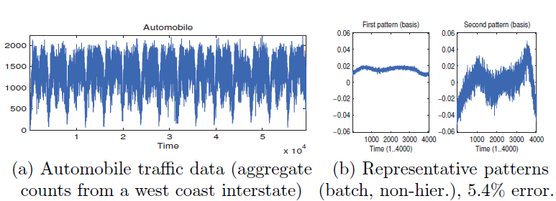
Example

Slide 26
Causation v.s. Correlation
Causation means that whenever there is a change in an explanatory variable, it should cause in a change in the response variable.
Correlations: Correlations between two variables are extremely common and easy to find. However, saying that two variables are correlated in NO way guarantees that there is causation.
Put another way: Having correlation without causation means that changing the explanatory variable will NOT guarantee a change in the response variable.

Slide 27
Example
One study in Victorian England showed a strong correlation between people wearing top hats, and their life expectancy. This relationship was shown to be very strong (high ‘r’).
Does this mean that had Queen Victoria provided free top-hats for all, the life expectancy in England would have shot up?
There is a confirmed correlation. However, there is NO causation. That is, wearing top hats does not cause people to live longer.
So, what’s going on here?
Answer: There is a lurking variable! In this case, there is the lurking variable is income. People with higher incomes could afford doctors and medicines. These were in no way a given in Victorian England!
So in this case, while there is correlation between top-hats and life epxectancy, there is no causation.
However, there would be a causal relationship between Income and life expectancy.

Slide 28
Example Correlation v.s. Causation
One study during the polio epidemic in the 1920s showed a strong correlation between ice cream consumption and cases of polio. As a result, the public was warned to avoid eating ice cream as it increased the risk of contracting the disease.
Thoughts?
Again, there was a strongly confirmed correlation. However, it turned out that there was NO causation. With a properly controlled experiment, it could have been easily shown that increased ice cream consumption did NOT increase the risk of polio.
Again, there was a lurking variable hiding in the background. It turns out that the virus that causes polio (a virus of the picornoviridae family for anyone who cares) thrives in warmer weather. So the lurking variable here was, temperature!

Slide 29
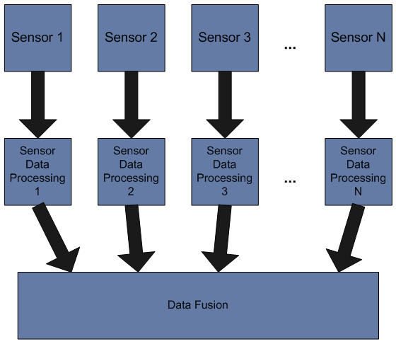
Data Fusion

Slide 30
Data Fusion
Data fusion is the process of integration of multiple data and knowledge representing the same real-world object into a consistent, accurate, and useful representation.
Fusion of the data from 2 sources (dimension #1 & #2) can yield a classifier superior to any classifiers based on dimension #1 or dimension #2 alone
Data fusion processes are often categorized as low, intermediate or high, depending on the processing stage at which fusion takes place. Low level data fusion combines several sources of raw data to produce new raw data. The expectation is that fused data is more informative and synthetic than the original inputs.

Slide 31
Decision Fusion
In detection and classification applications, decision fusion has attracted great interests for its advantages in combining the individual decisions into a unified one without sending raw data to the fusion centre. It provides a flexible solution for improving the classification accuracy without considering the classifiers used in local sensors.
Besides, the data transmission amount is greatly decreased, thus energy consumption and bandwidth demand are significantly reduced.
In decentralized target classification systems with decision fusion, each sensor independently conducts classification operation and uploads its local decision to the fusion center, which combines these decisions into a global one. Compared with target classification with a single sensor, multiple sensor decision fusion has better performance in classification accuracy, anti-noise, and reliability.

Slide 32
Definition
Data fusion is a multilevel, multifaceted process dealing with the
registration,
detection,
association,
correlation, and
combination of data and information
from multiple sources to achieve refined state and identity estimation, and complete and timely assessments of situation (including threats and opportunities).
Sensors produce individual observations or measurements (raw data) that must be placed in proper context first to create organized data sets (information) and then evaluated to infer higher-level meaning about the overall content in the information (knowledge).

Slide 33
Data Fusion
Registration: Registration (or alignment) is the process that places all sensor data in a common time and space coordinate system. This corrects for the different time sampling, viewing perspective and image planes of different sensors.
Detection: The decision regarding the presence or absence of an entity (e.g., target or aggregate of targets) or event (e.g., fire detection, missile launch) may be based upon the evaluation of multiple individual sensor decisions, or it may be based upon the combination of raw data from multiple sensors (often referred to as predetection fusion).

Slide 34
Data Fusion
Correlation and Association: The process of fusion which partitions data into associated categories includes correlation and association stages. Sensor measurements are compared with correlation metrics that use temporal, spectral or spatial properties to score each alternative assignment hypothesis. The sensor data are then associated with the corresponding data from other sensors and are assigned to categories.
Combination: The process of combining data from all sensors to derive a refined estimate of state and identity must manage the uncertainty in sensor measurements and provide estimates with associated measures of estimate uncertainty

